Slide 1
MARKETING ANALYTICS I
SESSION 15: FORECASTING
Professor Sonnier
Texas MSBA Program
Fall 2022

Slide 2
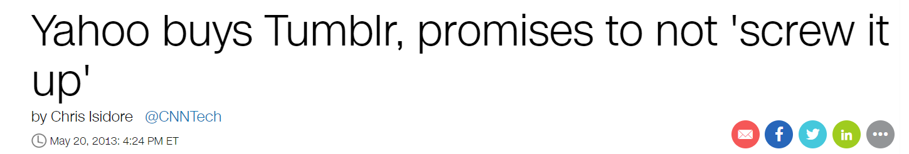

FORECASTING PLATFORM GROWTH
Yahoo Acquires Tumblr
How should we value Tumblr at the time of acquisition?

Slide 3
FORECASTING PLATFORM GROWTH
Yahoo! Acquires Tumblr
Imaging we have been tasked with providing an estimate for 10 year growth projection in people accessing site
Input into financial model

Slide 4
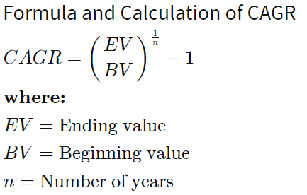
FORECASTING PLATFORM GROWTH
Some Observations
Over next ten years there will be ~7-8 billion people on the planet
Facebook currently has about 2.7 billion active users worldwide

Slide 5
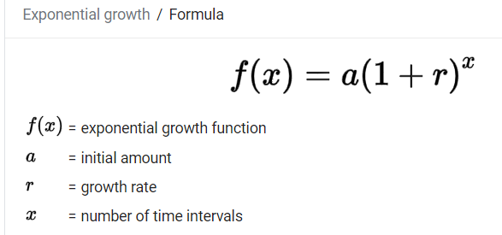
FORECASTING PLATFORM GROWTH
Some More Observations…
Growth Rate of 3.36%: Basically everyone on the planet is accessing
Growth Rate of 2.84%: Do you think this website is the next Facebook?

Slide 6
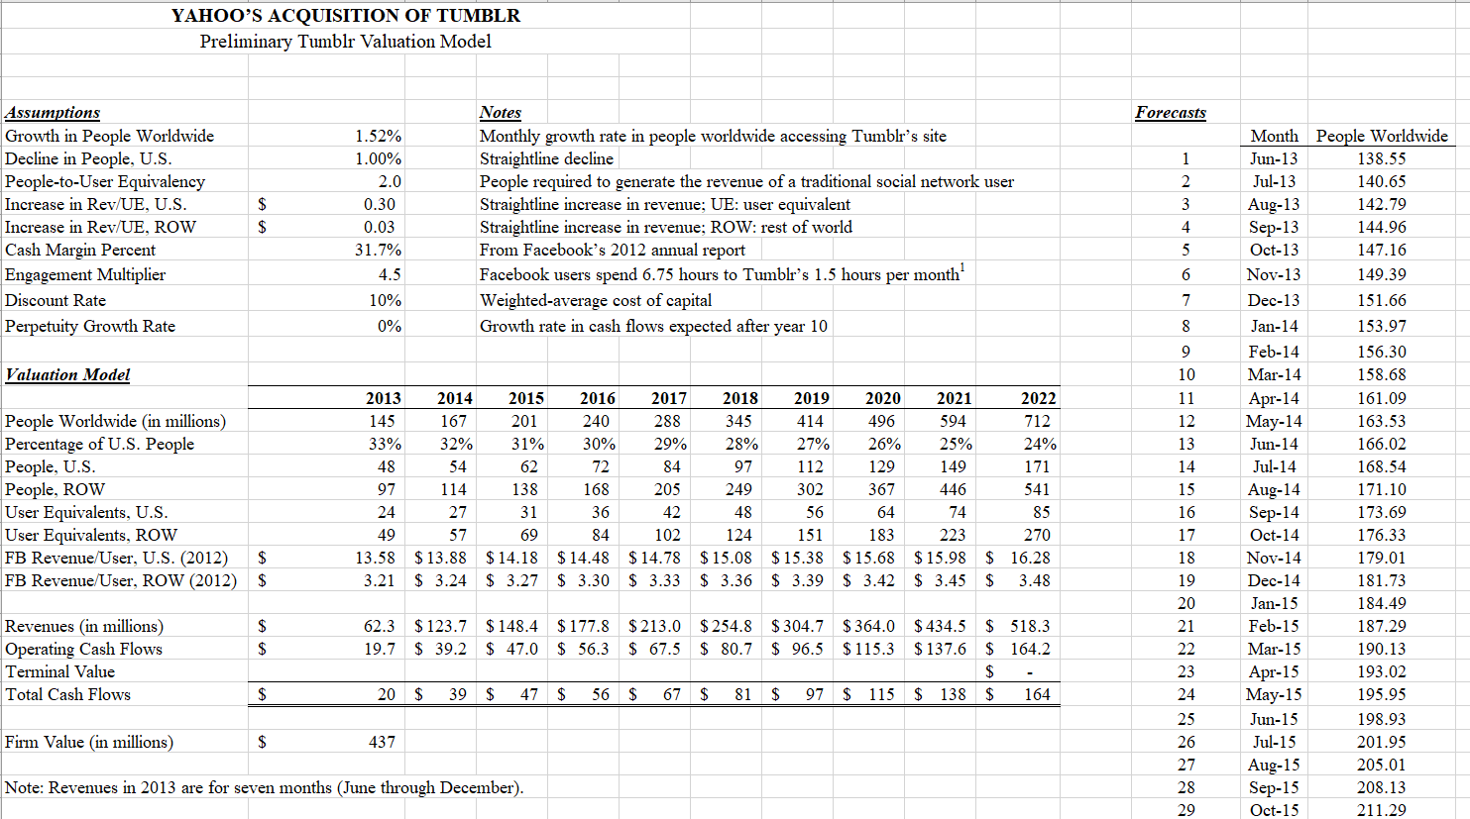
FORECASTING PLATFORM GROWTH
Ten Year Valuation Model with 2.84% CAGR in People

Slide 7
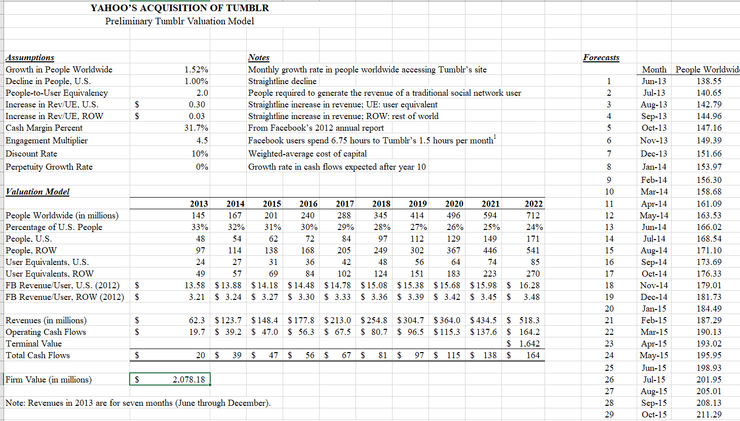
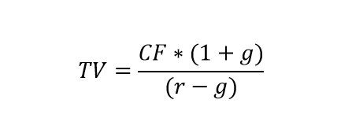
FORECASTING PLATFORM GROWTH
Ten Year Valuation Model with Flat Perpetuity and 2.84% CAGR in People
Terminal Value is Cash Flow (CF)*(1+Growth Rate In Cash Flow) / (Discount Rate – Growth Rate)

Slide 8
FORECASTING PLATFORM GROWTH
Let’s Think About Forecasting People Accessing the Site
Growth Rate of 3.36%: Basically everyone on the planet is accessing
Growth Rate of 2.84%: Do you think this website is the next Facebook?
How far back in the past should I go?

Slide 9
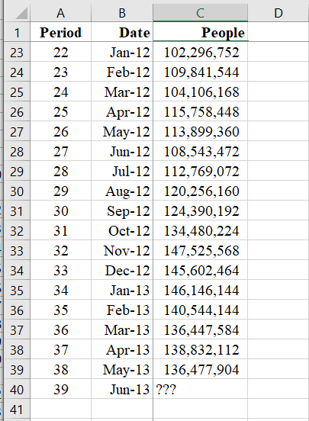
FORECASTING PLATFORM GROWTH
Let’s Take a Simple Approach First
Two Naïve Approaches to Forecast June 2013
All Period Average
Previous Period

Slide 10
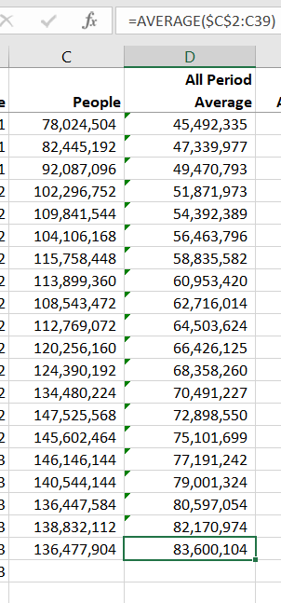
FORECASTING PLATFORM GROWTH
Simple Approaches
All Period Average
In second period, compute average of first two periods
In third period, compute average of first three
In N^{th} period compute average of first N

Slide 11
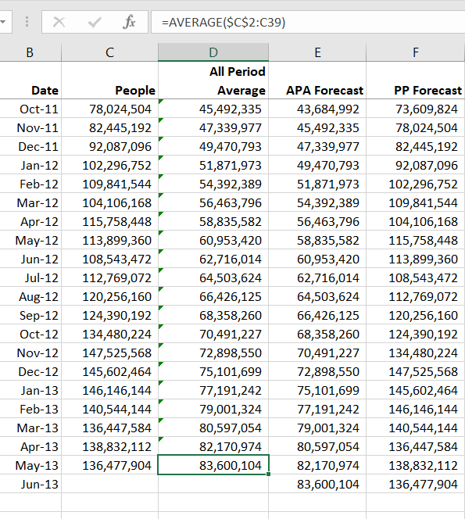
FORECASTING PLATFORM GROWTH
Simple Approaches
All Period Average (APA) forecast
Value of APA in previous period
Previous Period (PP) forecast
Value of Miles in previous period
Let’s Combine these
Not as simple…

Slide 12
FORECASTING PLATFORM GROWTH
Smoothing to Combine Information
We want something between simple average of all previous periods and only the most recent period

Slide 13
FORECASTING PLATFORM GROWTH
Smoothing to Combine Information
We want something between simple average of all previous periods and only the most recent period

Slide 14
FORECASTING PLATFORM GROWTH
Smoothing to Combine Information
Now I can substitute each equation into the next one

Slide 15
FORECASTING PLATFORM GROWTH
Smoothing to Combine Information
As alpha approaches one more weight is given to recent past
As alpha approaches zero more weight is given to distant past

Slide 16
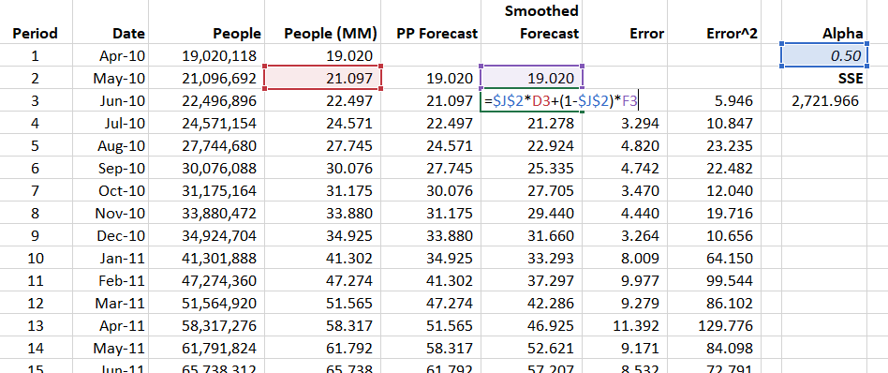
FORECASTING PLATFORM GROWTH
Smoothing to Combine Information
Start in May 2010 with Apr 2010 as initial forecast.
In Jun 2010 forecast is weighted average of May 2010 actual and forecasted value for May 2010

Slide 17
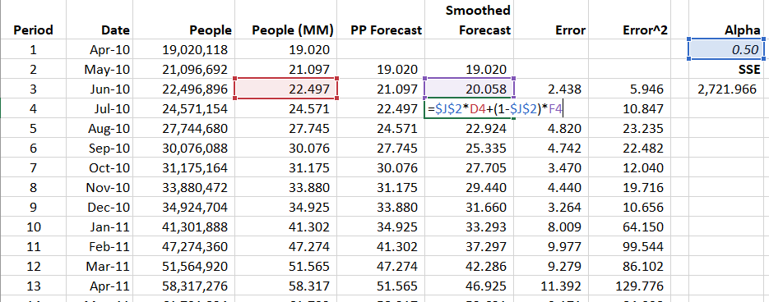
FORECASTING PLATFORM GROWTH
Smoothing to Combine Information
In Jul 2010 forecast is weighted average of Jun 2010 actual and forecasted value for Jun 2010

Slide 18
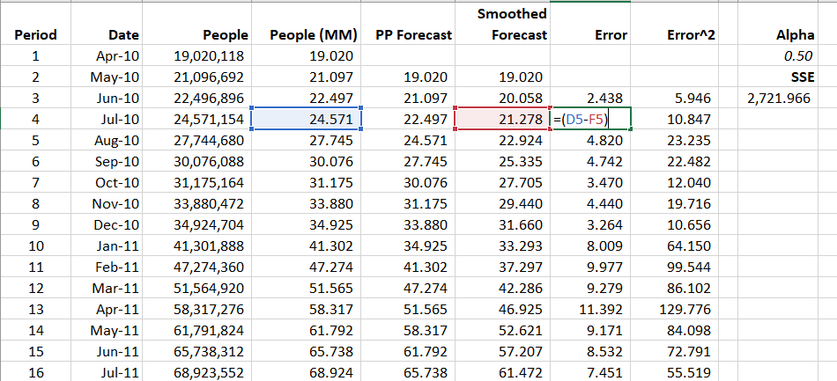
FORECASTING PLATFORM GROWTH
Estimate Alpha by Minimizing SSE

Slide 19
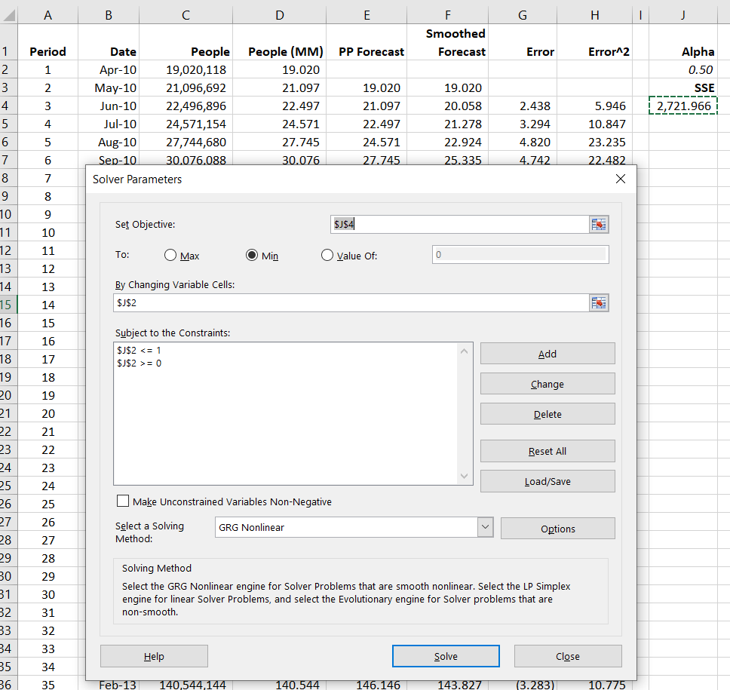
FORECASTING PLATFORM GROWTH
Estimate Alpha by Minimizing SSE

Slide 20
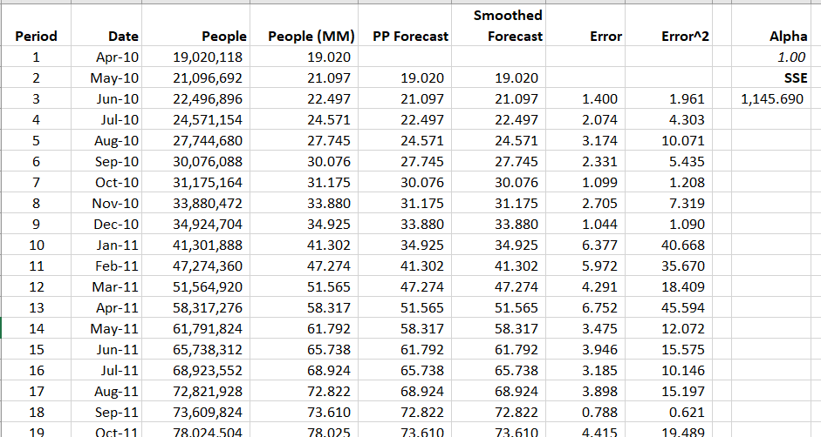
FORECASTING PLATFORM GROWTH
Optimal Alpha is One! Hmm…

Slide 21
FORECASTING PLATFORM GROWTH
Strong Trend in Data
We are going to need a better mousetrap

Slide 22
FORECASTING PLATFORM GROWTH
Linear Trend
Growth looks pretty linear

Slide 23
FORECASTING PLATFORM GROWTH
Logarithmic Trend
Growth looks pretty linear

Slide 24
FORECASTING PLATFORM GROWTH
Exponential Trend
Growth looks pretty linear

Slide 25
FORECASTING PLATFORM GROWTH
Improving our Forecast
We want to break our data down into component pieces
Baseline Level
Observed Value
Trend

Slide 26
FORECASTING PLATFORM GROWTH
Improving our Forecast
We want to make component pieces dynamic
We will use exponential smoothing to dynamically update the level, trend of the forecast
Baseline Level at time t
Observed Value at time t
Trend at time t

Slide 27
FORECASTING PLATFORM GROWTH
Smoothed Level and Trend Model*
Steps to compute forecasts (it’s complicated…)
Choose initial values for smoothing parameters between 0 and 1
Initialize Level, Trend for period prior to initial forecast period
Compute dynamically updated values of Level and Trend
Compute forecasts, errors and SSE
Choose smoothing parameters to minimize SSE
Re-compute forecasts at optimal values of smoothing parameters (automatic)
NOTE: This model is called a Holt Model. If you Google it you will see it comes in linear and multiplicative forms

Slide 28
FORECASTING PLATFORM GROWTH
Smoothed Level and Trend Model
Quantities in the model
Dynamic updating equations: Linear Model

Slide 29
FORECASTING PLATFORM GROWTH
Smoothed Level and Trend Model
Steps to compute forecasts (it’s complicated…)
Choose initial values for smoothing parameters between 0 and 1
Initialize Level, Trend, and Seasonal parameters for period prior to initial forecast period
Compute dynamically updated values of Level, Trend, and Seasonal parameters
Compute forecasts, errors and SSE
Choose smoothing parameters to minimize SSE
Re-compute forecasts at optimal values of smoothing parameters

Slide 30
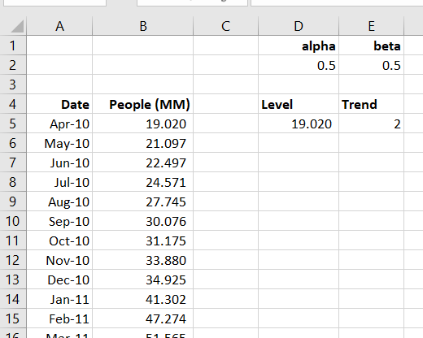
FORECASTING PLATFORM GROWTH
Initialize Model

Slide 31
FORECASTING PLATFORM GROWTH
Smoothed Level and Trend: Linear Model
Steps to compute forecasts (it’s complicated…)
Choose initial values for smoothing parameters between 0 and 1
Initialize Level, Trend, and Seasonal parameters for period prior to initial forecast period
Compute dynamically updated values of Level and Trend
Compute forecasts, errors and SSE
Choose smoothing parameters to minimize SSE
Re-compute forecasts at optimal values of smoothing parameters
NOTE: This model is called a Holt-Winters model. If you Google it you will see it comes in linear, multiplicative, and mixed forms. We are working with a linear Holt-Winters model.

Slide 32
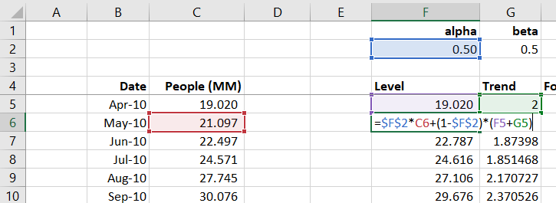
FORECASTING PLATFORM GROWTH
Dynamic Updating: Level

Slide 33
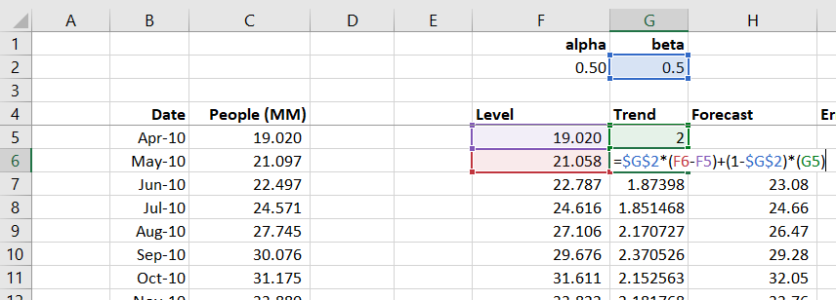
FORECASTING PLATFORM GROWTH
Dynamic Updating: Trend

Slide 34
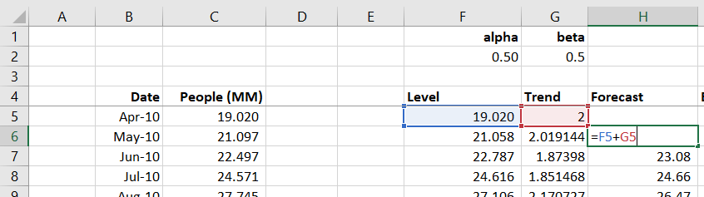
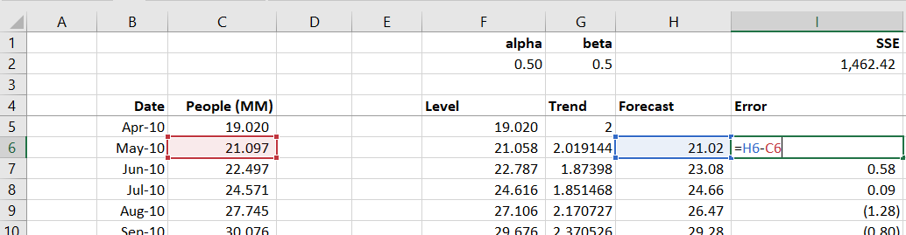
FORECASTING PLATFORM GROWTH
Compute Forecast and Error
Forecast
Error

Slide 35
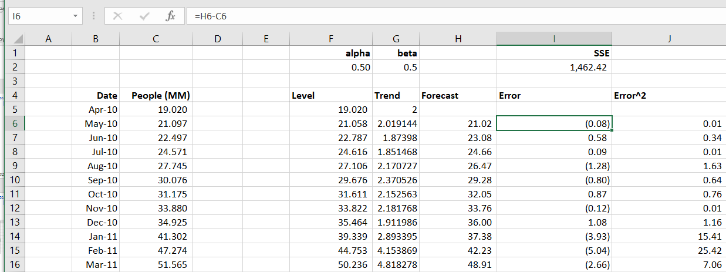
FORECASTING PLATFORM GROWTH
Compute SSE

Slide 36
FORECASTING PLATFORM GROWTH
Smoothed Level and Trend Model
Steps to compute forecasts (it’s complicated…)
Choose initial values for smoothing parameters between 0 and 1
Initialize Level, Trend, and Seasonal parameters for period prior to initial forecast period
Compute dynamically updated values of Level, Trend, and Seasonal parameters
Compute forecasts, errors and SSE
Choose smoothing parameters to minimize SSE
Re-compute forecasts at optimal values of smoothing parameters (automatic)

Slide 37
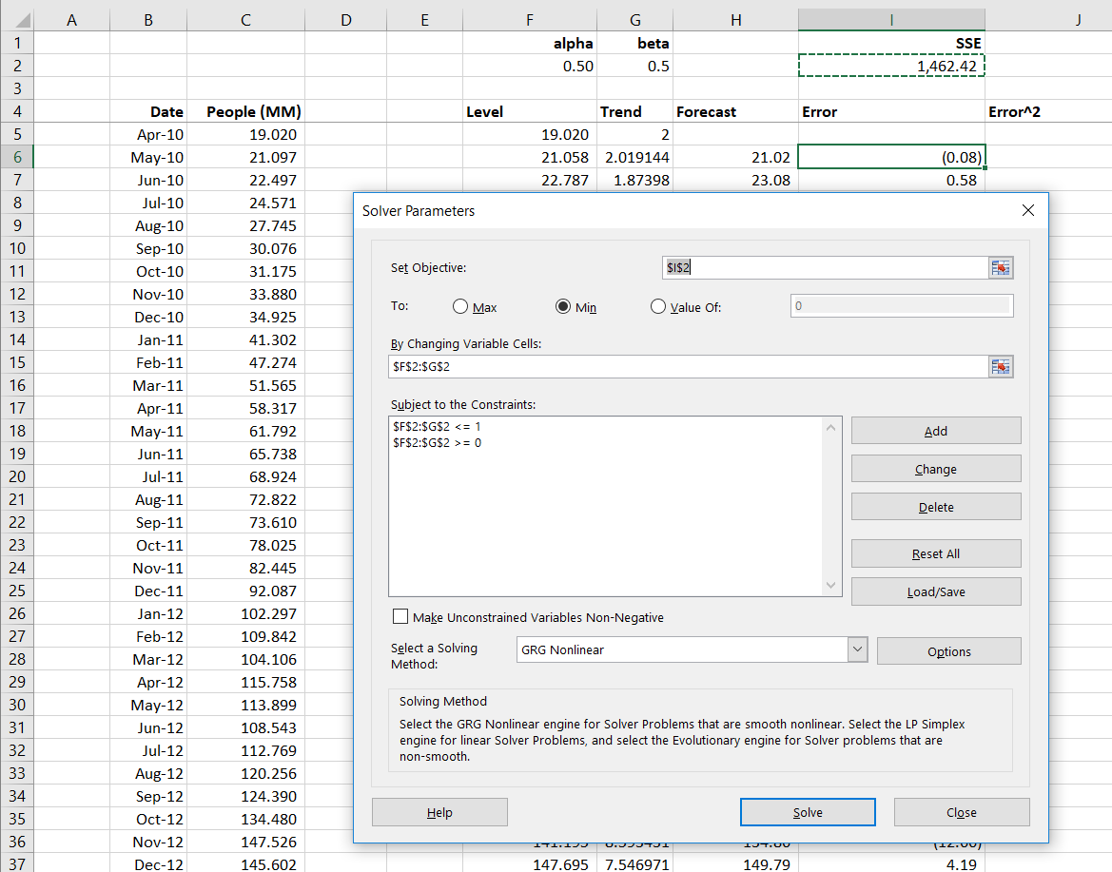
FORECASTING PLATFORM GROWTH
Finding Optimal Parameters

Slide 38
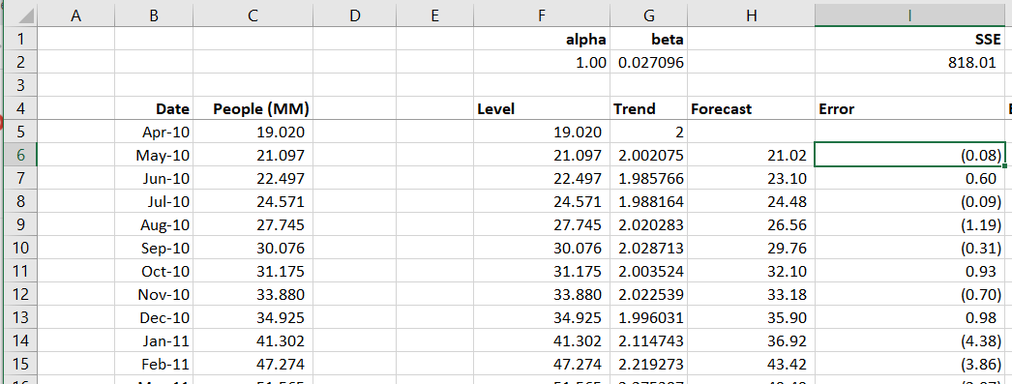
FORECASTING PLATFORM GROWTH
Finding Optimal Parameters
Model basically saying 1 step forecast is whatever series was last month plus a dynamically updating trend term

Slide 39
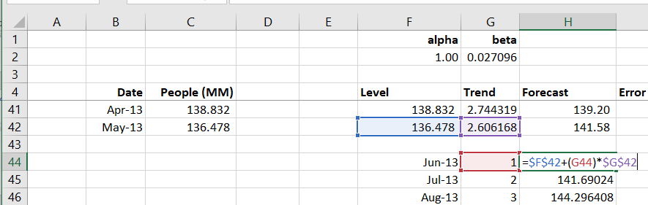
FORECASTING PLATFORM GROWTH
Building Out Forecast
First June
Just the one-step forecast

Slide 40
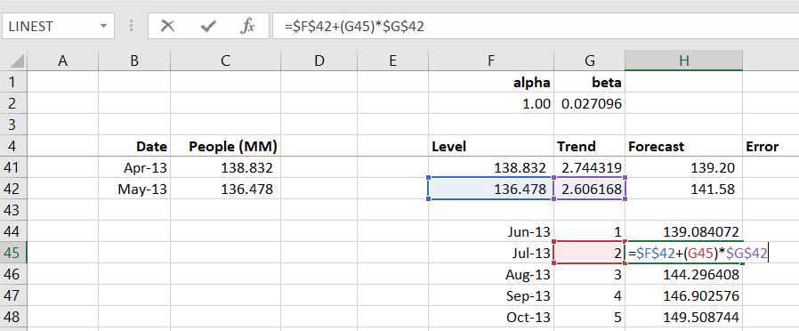
FORECASTING PLATFORM GROWTH
Building Out Forecast
Now July
Use May level and trend with trend multiplier
Repeat for remaining months

Slide 41
FORECASTING PLATFORM GROWTH
Building Out Forecast
Valuation model will take average of 12 months to compute valuation of Tumblr

Slide 42
FORECASTING PLATFORM GROWTH: TERMINAL AT YEAR 10

Slide 43
FORECASTING PLATFORM GROWTH: FLAT PERPETUITY

Slide 44
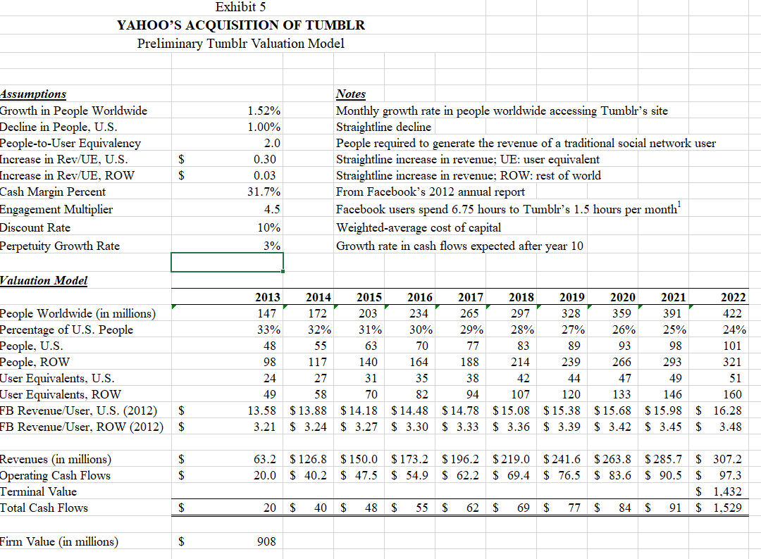
FORECASTING PLATFORM GROWTH: PERPETUITY WITH 3% GROWTH

Slide 45
FORECASTING AND MARKET ASSESSMENT
Data Visualization
The data exhibit some trend and some seasonality
Can we expand our model to account for seasonality? Why yes we can!
NOTE: Airline Mile Data Student file on Canvas

Slide 46
FORECASTING AND MARKET ASSESSMENT
Forecasting Air Miles Travelled
We want to break our data down into component pieces
Baseline Level
Observed Value
Trend
Seasonality

Slide 47
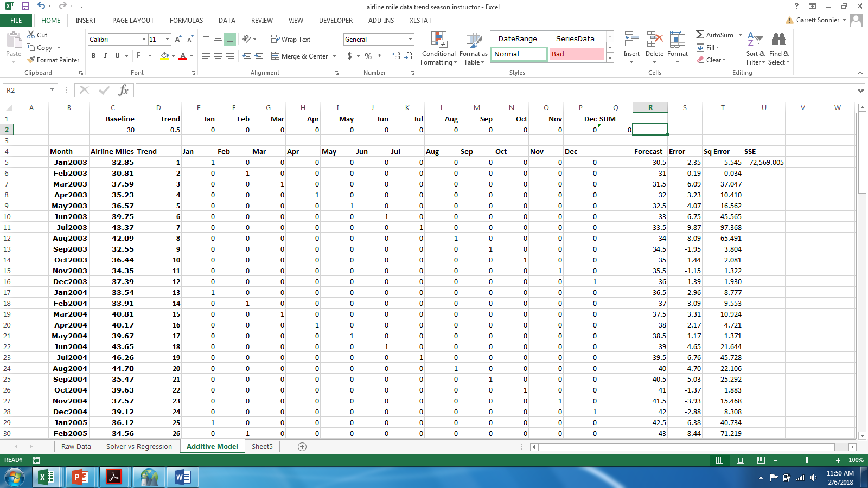
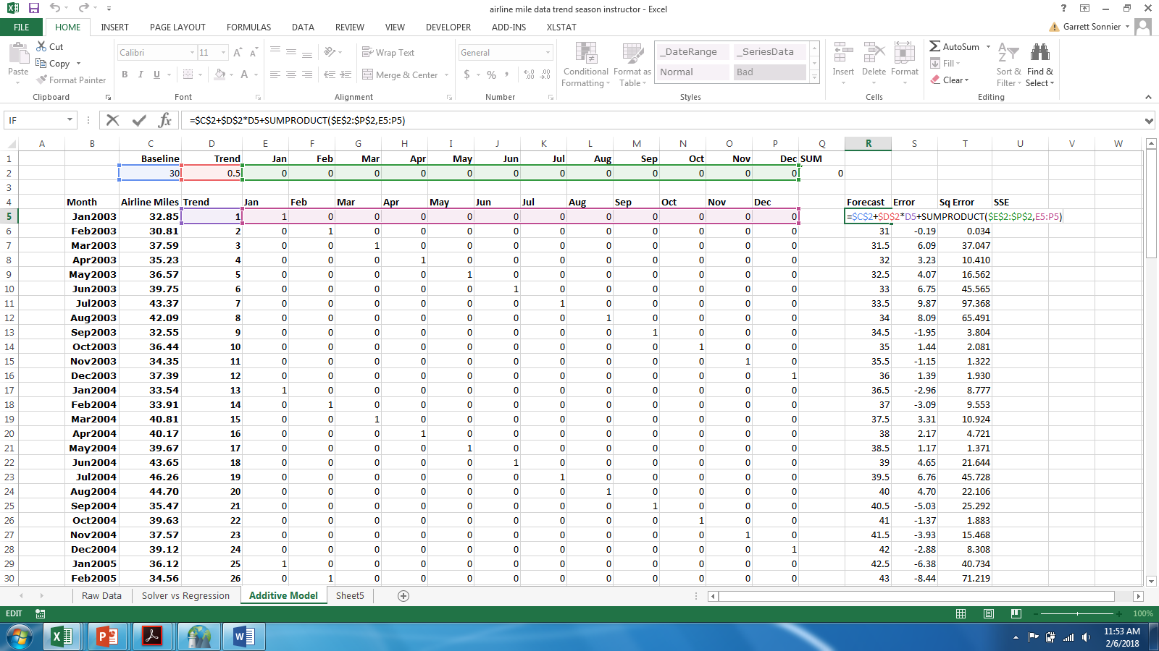
FORECASTING AND MARKET ASSESSMENT
Initialize the Model
I need a starting guess for baseline, trend and seasonal indices
Based on this starting guess I compute a forecast

Slide 48
FORECASTING AND MARKET ASSESSMENT
Compute Sum of Squared Errors and Solve
With my forecast (based on my initial guess) I compute the error, the squared error, and the sum of squared errors
Use solver to search for values of the coefficients (baseline, trend, and seasonal indices) that minimizes SSE

Slide 49
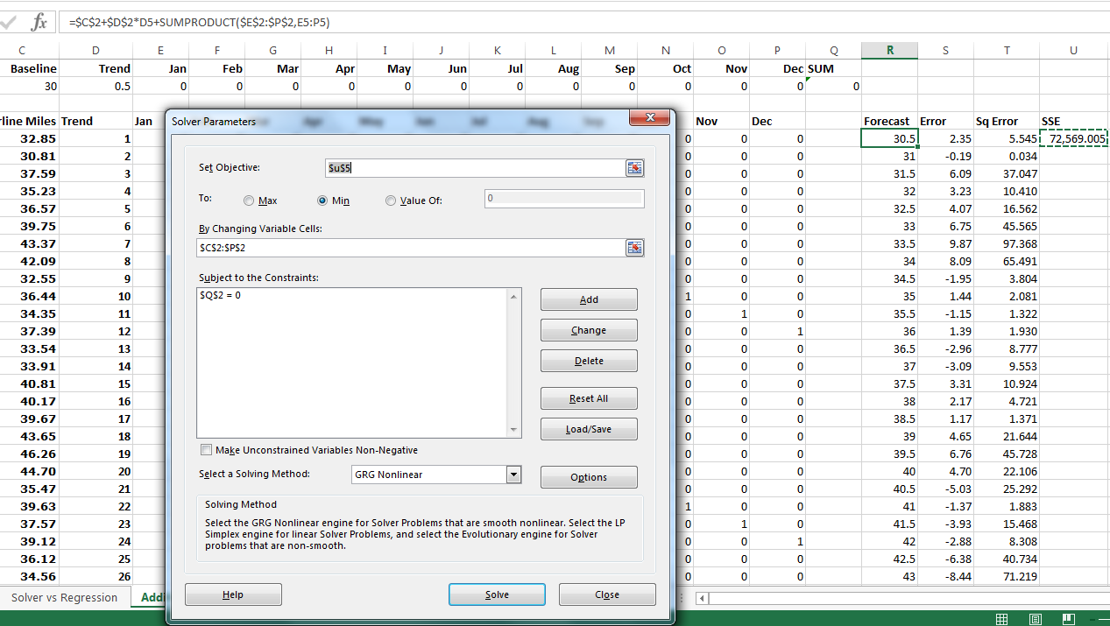
FORECASTING AND MARKET ASSESSMENT
Compute Sum of Squared Errors and Solve

Slide 50
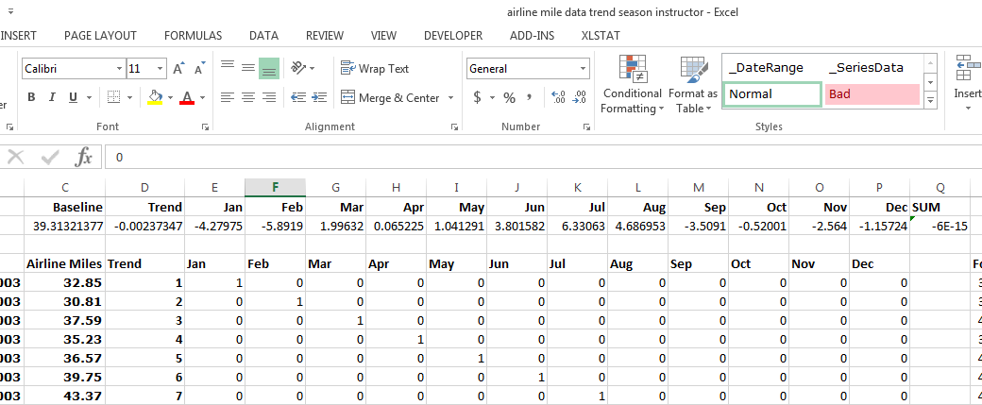
FORECASTING AND MARKET ASSESSMENT
Compute Sum of Squared Errors and Solve
Baseline Level
Level of miles travelled at beginning of period is ~39.31 billion
Trend
There is little to no stable linear trend
Seasonality
Miles travelled peaks in July (~6.33 billion above average)
Miles travelled bottoms out in Feb (~5.89 billion below average)

Slide 51
FORECASTING AND MARKET ASSESSMENT
Improving our Forecast
Additive Model with Trend and Seasonality
Baseline Coefficient at Initial Period
+
Observed Value
Trend Coefficient x Trend Value
=
+
Seasonal Coefficient x Seasonal Value
Estimate Baseline, Trend, and Seasonal Coefficients
Compute forecast and minimize SSE

Slide 52
FORECASTING AND MARKET ASSESSMENT
Improving our Forecast
We want to break our data down into dynamic component pieces
We will use exponential smoothing to dynamically update the level, trend, and seasonal components of the forecast
Baseline Level at time t
Observed Value at time t
Trend at time t
Seasonality at time t

Slide 53
FORECASTING AND MARKET ASSESSMENT
Smoothed Level, Trend, and Seasonality Model*
Steps to compute forecasts (it’s complicated…)
First estimate a stationary L,T,S model (like we just did) on only 2 seasons of the data (24 observations for monthly data, 8 observations for quarterly data).
Recover estimates of seasonal indices (monthly or quarterly) and trend
Choose initial values for smoothing parameters between 0 and 1
Initialize Level, Trend, and Seasonal parameters for period prior to initial forecast period
Compute dynamically updated values of Level, Trend, and Seasonal parameters
Compute forecasts, errors and SSE
Choose smoothing parameters to minimize SSE
Re-compute forecasts at optimal values of smoothing parameters
NOTE: This model is called a Holt-Winters model. If you Google it you will see it comes in linear, multiplicative, and mixed forms. We are working with a linear Holt-Winters model.

Slide 54
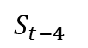
FORECASTING AND MARKET ASSESSMENT
Smoothed Level, Trend, and Seasonality Model*
Quantities in the model
Dynamic updating equations
NOTE: For quarterly data the seasonal adjustment would be
$$S_{t−4}$$

Slide 55
FORECASTING AND MARKET ASSESSMENT
Smoothed Level, Trend, and Seasonality Model*
Steps to compute forecasts (it’s complicated…)
First estimate a stationary L,T,S model (like we just did) on 2 seasons of the data (24 observations for monthly data, 8 observations for quarterly data).
Recover estimates of seasonal indices (monthly or quarterly) and trend
Choose initial values for smoothing parameters between 0 and 1
Initialize Level, Trend, and Seasonal parameters for period prior to initial forecast period
Compute dynamically updated values of Level, Trend, and Seasonal parameters
Compute forecasts, errors and SSE
Choose smoothing parameters to minimize SSE
Re-compute forecasts at optimal values of smoothing parameters
NOTE: This model is called a Holt-Winters model. If you Google it you will see it comes in linear, multiplicative, and mixed forms. We are working with a linear Holt-Winters model.

Slide 56
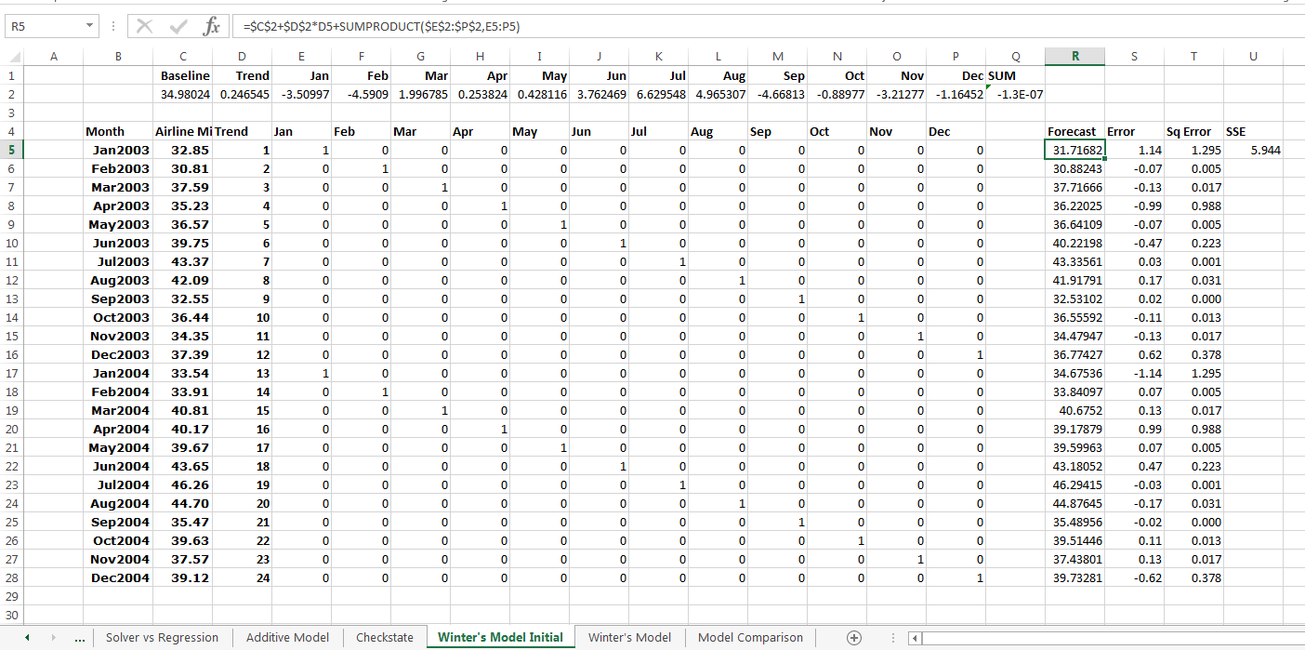
FORECASTING AND MARKET ASSESSMENT
Initialization of Trend and Seasonal Indices

Slide 57
FORECASTING AND MARKET ASSESSMENT
Smoothed Level, Trend, and Seasonality Model*
Steps to compute forecasts (it’s complicated…)
First estimate a stationary L,T,S model (like we just did) on 2 seasons of the data (24 observations for monthly data, 8 observations for quarterly data).
Recover estimates of seasonal indices (monthly or quarterly) and trend
Choose initial values for smoothing parameters between 0 and 1
Initialize Level, Trend, and Seasonal parameters for period prior to initial forecast period
Compute dynamically updated values of Level, Trend, and Seasonal parameters
Compute forecasts, errors and SSE
Choose smoothing parameters to minimize SSE
Re-compute forecasts at optimal values of smoothing parameters
NOTE: This model is called a Holt-Winters model. If you Google it you will see it comes in linear, multiplicative, and mixed forms. We are working with a linear Holt-Winters model.

Slide 58
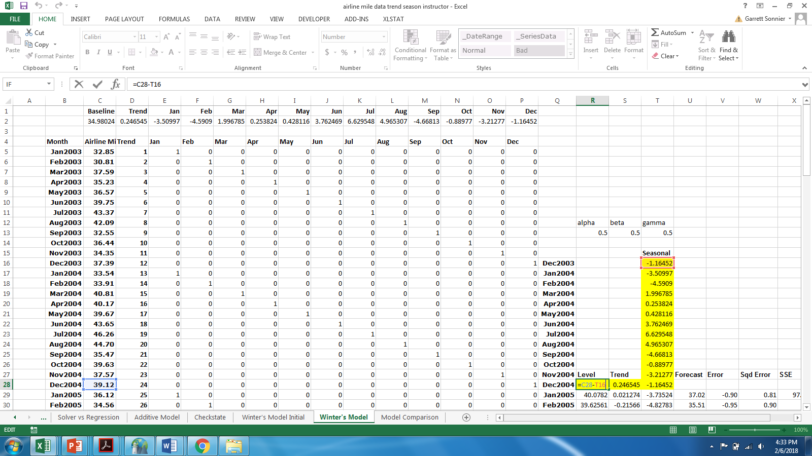
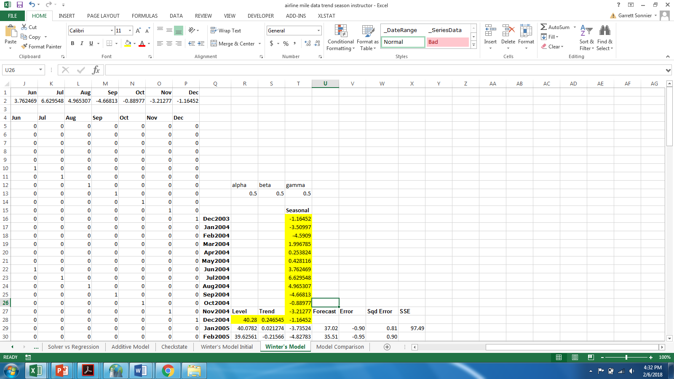
FORECASTING AND MARKET ASSESSMENT
Initialization of Trend and Seasonal Indices

Slide 59
FORECASTING AND MARKET ASSESSMENT
Smoothed Level, Trend, and Seasonality Model*
Steps to compute forecasts (it’s complicated…)
First estimate a stationary L,T,S model (like we just did) on 2 seasons of the data (24 observations for monthly data, 8 observations for quarterly data).
Recover estimates of seasonal indices (monthly or quarterly) and trend
Choose initial values for smoothing parameters between 0 and 1
Initialize Level, Trend, and Seasonal parameters for period prior to initial forecast period
Compute dynamically updated values of Level, Trend, and Seasonal parameters
Compute forecasts, errors and SSE
Choose smoothing parameters to minimize SSE
Re-compute forecasts at optimal values of smoothing parameters
NOTE: This model is called a Holt-Winters model. If you Google it you will see it comes in linear, multiplicative, and mixed forms. We are working with a linear Holt-Winters model.

Slide 60
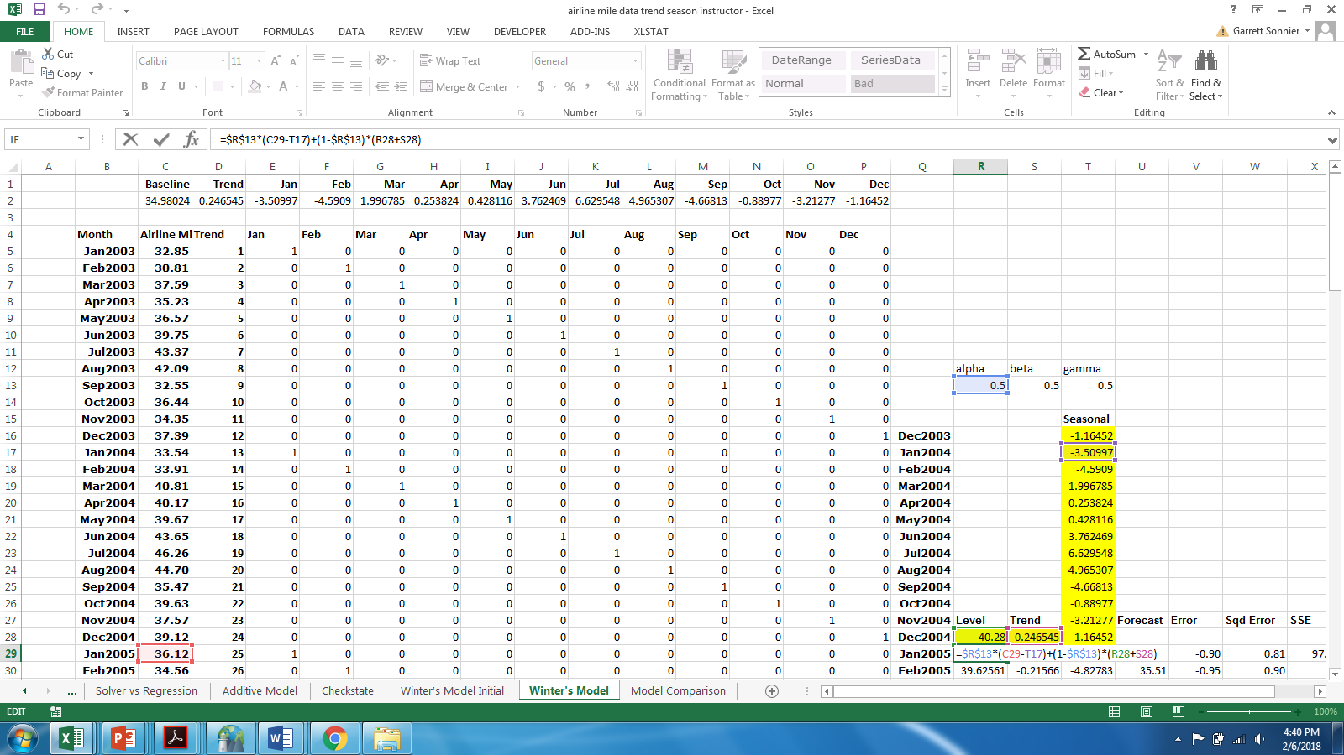
FORECASTING AND MARKET ASSESSMENT
Dynamic Updating: Level

Slide 61
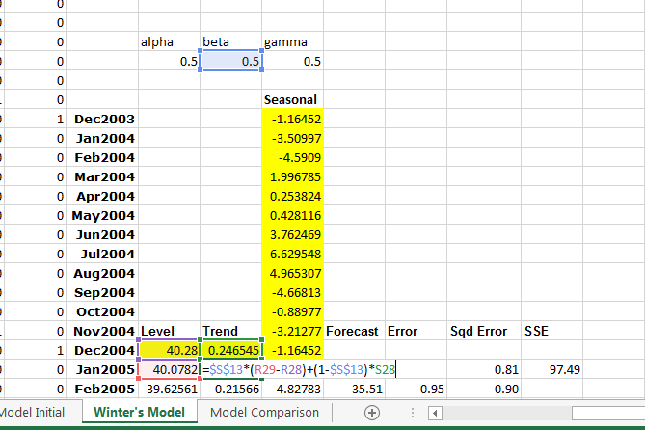
FORECASTING AND MARKET ASSESSMENT
Dynamic Updating: Trend

Slide 62
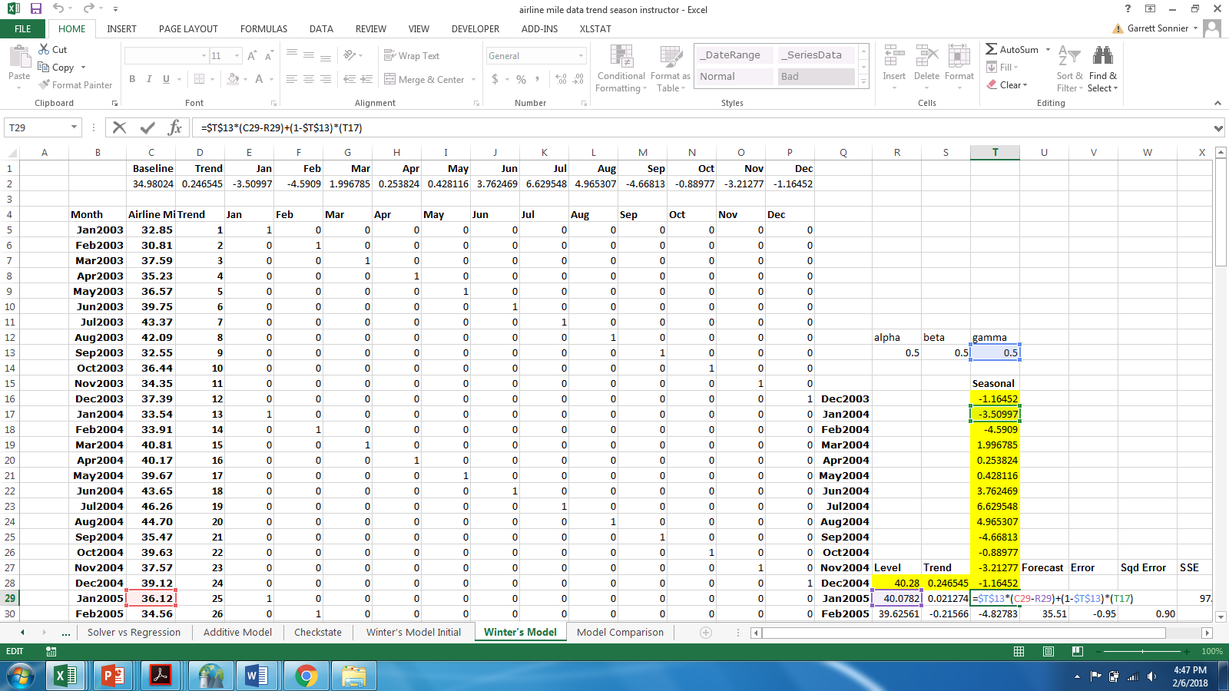
FORECASTING AND MARKET ASSESSMENT
Dynamic Updating: Seasonality

Slide 63
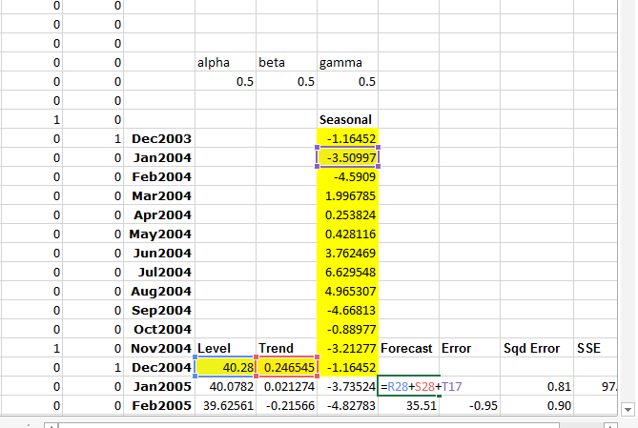
FORECASTING AND MARKET ASSESSMENT
Compute Forecast

Slide 64
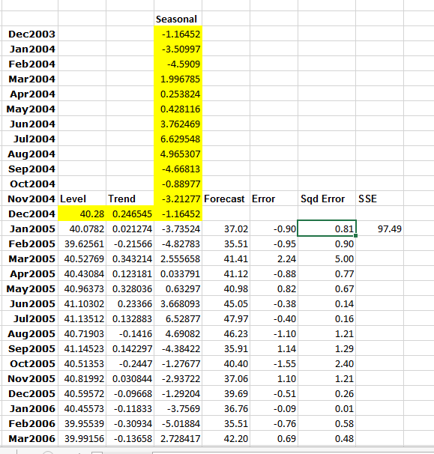
FORECASTING AND MARKET ASSESSMENT
Compute Error, Squared Error and SSE

Slide 65
FORECASTING AND MARKET ASSESSMENT
Smoothed Level, Trend, and Seasonality Model*
Steps to compute forecasts (it’s complicated…)
First estimate a stationary L,T,S model (like we just did) on 2 seasons of the data (24 observations for monthly data, 8 observations for quarterly data).
Recover estimates of seasonal indices (monthly or quarterly) and trend
Choose initial values for smoothing parameters between 0 and 1
Initialize Level, Trend, and Seasonal parameters for period prior to initial forecast period
Compute dynamically updated values of Level, Trend, and Seasonal parameters
Compute forecasts, errors and SSE
Choose smoothing parameters to minimize SSE
Re-compute forecasts at optimal values of smoothing parameters
NOTE: This model is called a Holt-Winters model. If you Google it you will see it comes in linear, multiplicative, and mixed forms. We are working with a linear Holt-Winters model.

Slide 66
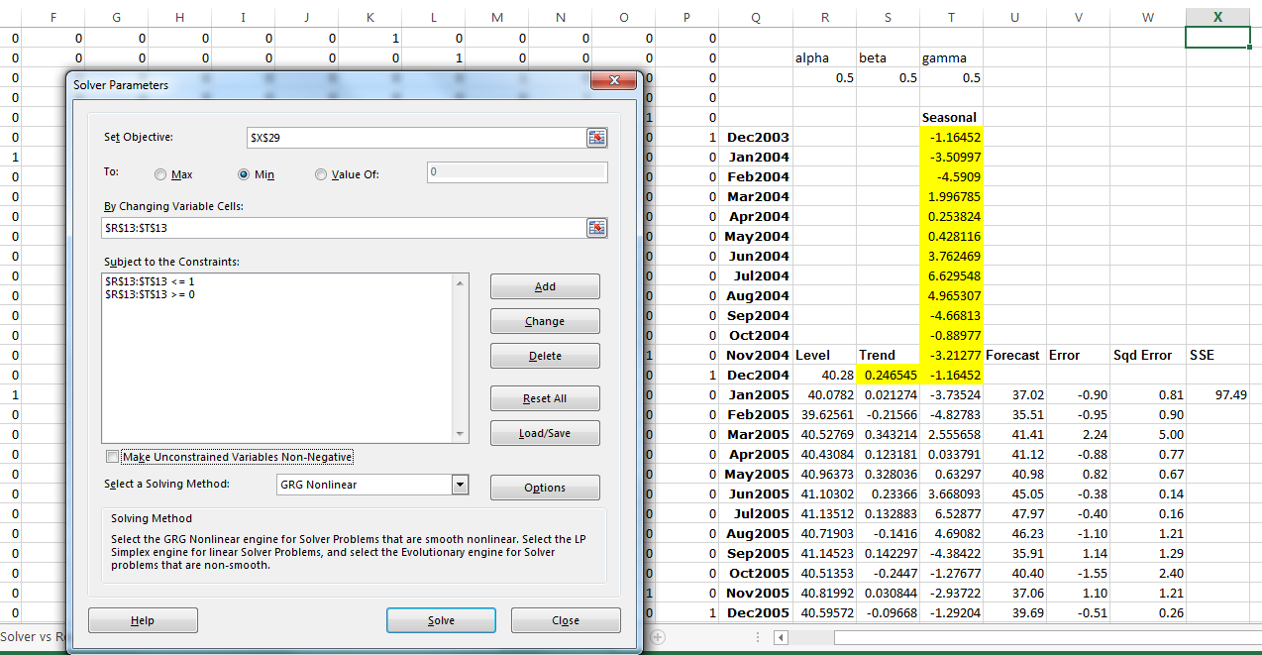
FORECASTING AND MARKET ASSESSMENT
Choose Optimal Smoothing Parameters

Slide 67
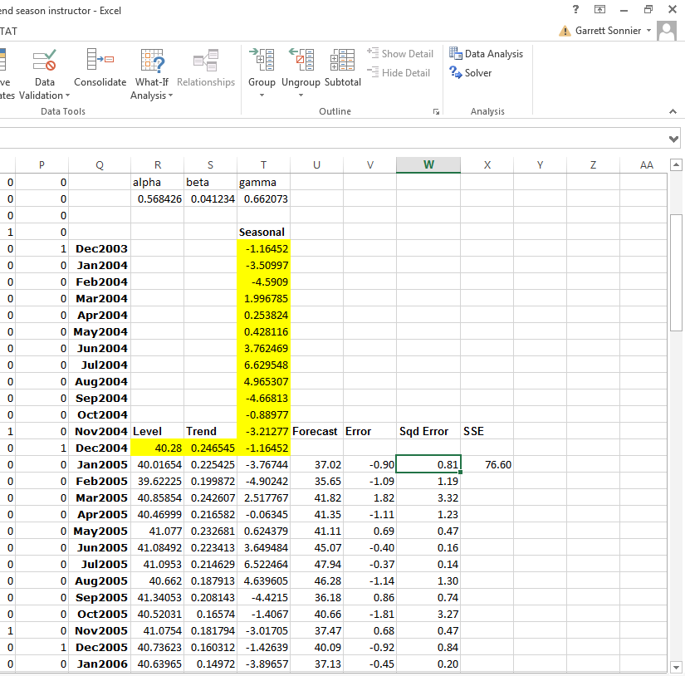
FORECASTING AND MARKET ASSESSMENT
Optimal Smoothing and Forecast

Slide 68
FORECASTING AND MARKET ASSESSMENT
Forecast Comparison

Slide 69
FORECASTING AND MARKET ASSESSMENT
Forecast Comparison vs. Actual

Slide 70
FORECASTING AND MARKET ASSESSMENT
Forecast Comparison vs. Actual (Last 12 Months)

Slide 71
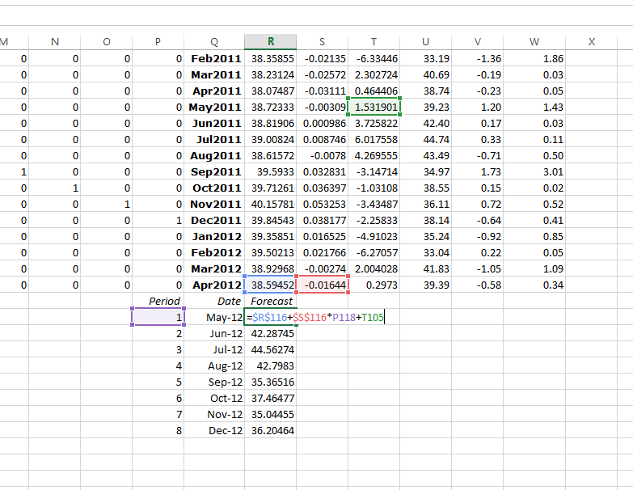
FORECASTING AND MARKET ASSESSMENT
Forecasting to More than One Period from Last Period: First May

Slide 72
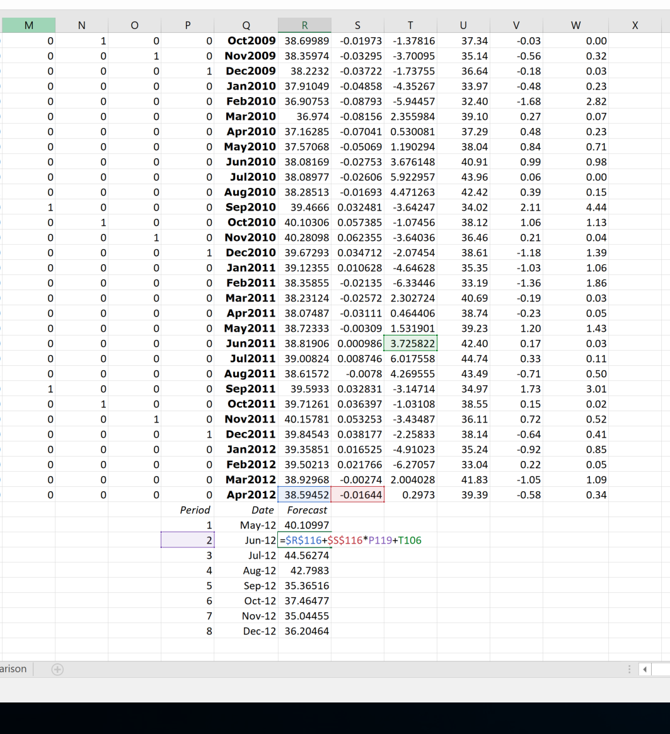
FORECASTING AND MARKET ASSESSMENT
Forecasting to More than One Period from Last Period: Now June

Slide 73
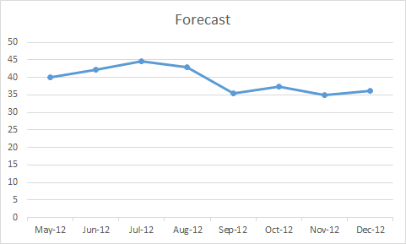
FORECASTING AND MARKET ASSESSMENT
Forecasting to More than One Period from Last Period
We see demand projected to peak in summer months and falling off in winter

Slide 74
FORECASTING
Forecasting to More than One Period from Last Period
Be wary of limits to growth
How realistic is it for Tumblr to conquer the globe or even replicate Facebook?
Exponential smoothing gives us a way to balance recent and distant past
We can apply exponential smoothing to a level baseline, a trend, and even to seasonality parameters
Models come in linear form (discussed in class) and multiplicative form (not discussed)
Models can be written to maximize a statistical likelihood allowing for forecast confidence intervals

